Slide 1
codes rule the aiR
cs538 course presentation by tanvir amin

Slide 2
Question
We employ coding in the Physical layer and in the Application layer. But what about doing it in Layer - 3 ?
Does it help ?

Slide 3
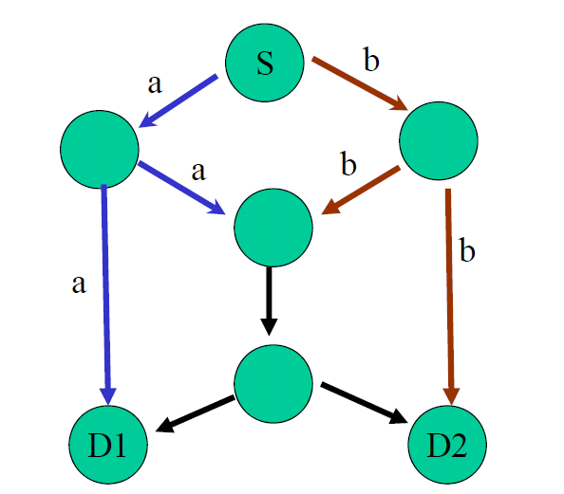
Network Coding
Good News: It was found that allowing routers to mix the bits in forwarding messages can increase network throughput.
Not so Good News: This coding is beneficiary for multicast traffic. For unicast no special benefit had been found.
Really?
Ahlswede et al. – Butterfly Example in “Network Information Flow”, IEEE Transactions on Information Theory, 2000

Slide 4
What about wireless ?
Wait … Wait … Why do you make distinctions of wired and wireless ?
Its trivial !! Todays presentation topic is Wireless ☺
Any REAL reasons ?
Inherently Broadcast
Unreliable
Transmission power Exponential in terms of coverage
Increasing power doesn’t help. Causes Interference

Slide 5
XORs in the Air:
Practical Wireless Network Coding
Sachin Katti, Hariharan Rahul, Wenjun Hu, Dina Katabi, Muriel Medard, Jon Crowcroft
SIGCOMM 2006

Slide 6
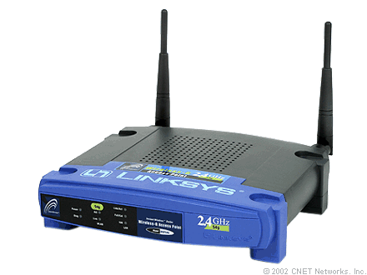
Trivial way to relay a packet
Transmission 1
Relay
Transmission 2
Alice
A
B
Bob
B
A
Transmission 3
Transmission 4
4 transmissions

Slide 7
An intelligent way
Transmission 1
Relay
Transmission 2
Alice
A
B
Bob
A XOR B
A XOR B
Transmission 3
Transmission 3
3 transmissions

Slide 8
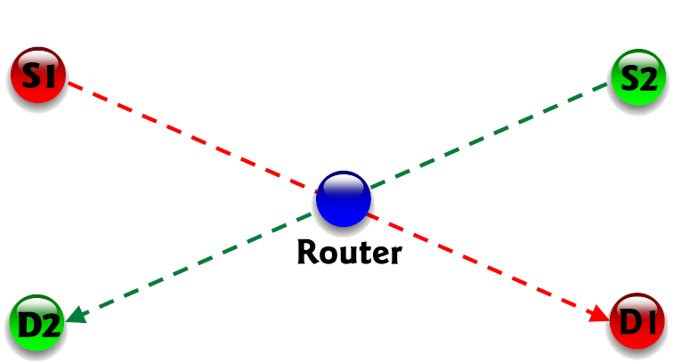
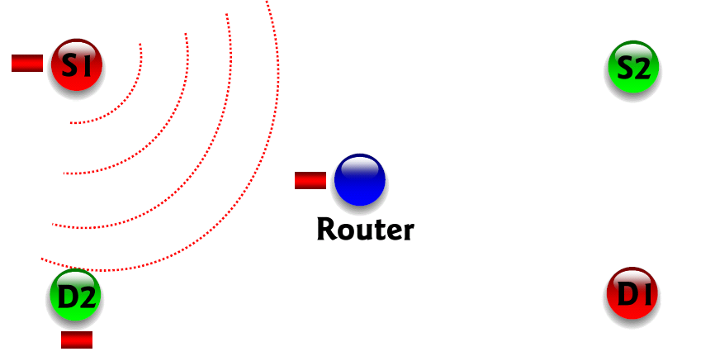
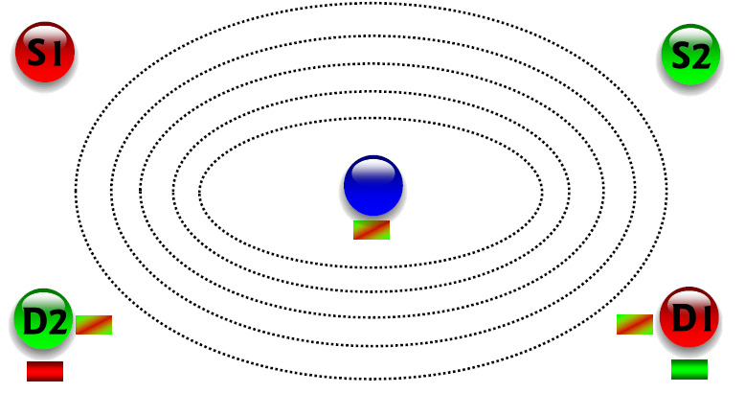
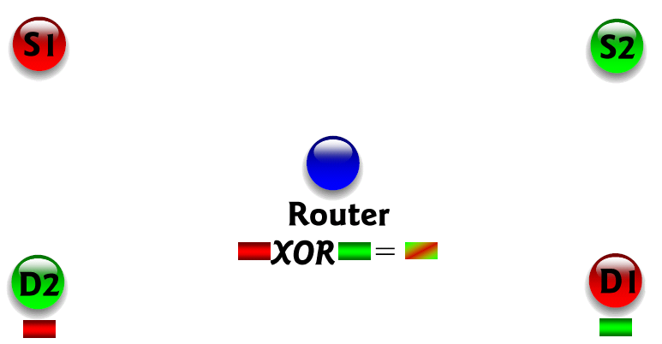
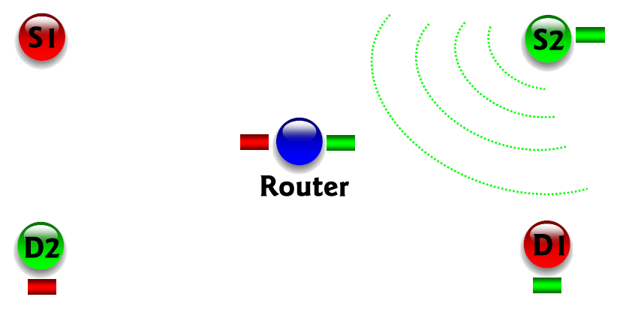
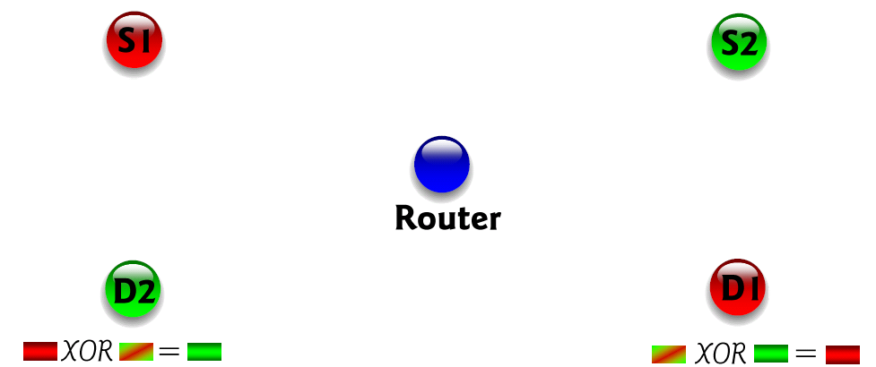
X Topology
Again 3 transmissions

Slide 9
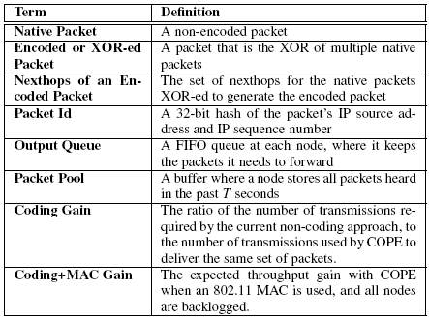
Terminology

Slide 10
Techniques
Three main techniques:
Opportunistic Listening
Opportunistic Coding
Learning Neighbor State

Slide 11
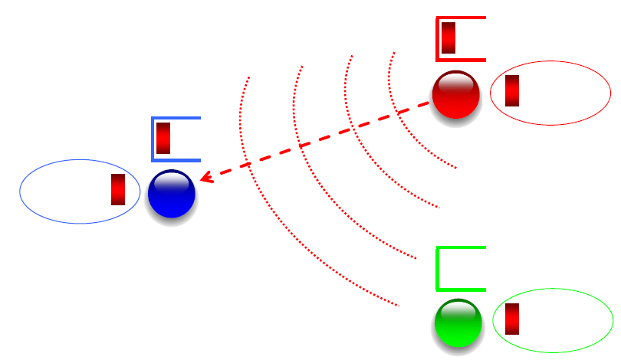
Opportunistic Listening
COPE sets the nodes to a promiscuous mode.
The nodes store the overheard packets for a short period T (say 0.5 s)
Each node also broadcasts reception reports to tell it’s neighbors which packets it has stored.
Illustration Credit: Author’s slide at SIGCOMM’06

Slide 12
Opportunistic Coding
“A node should aim to maximize the number of native packets delivered in a single transmission, while ensuring that each intended next-hop has enough information to decode it’s native packet.”

Slide 13
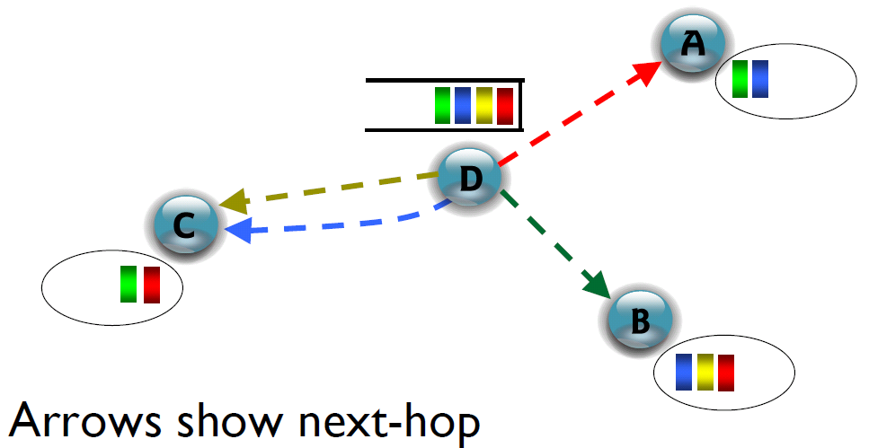
Opportunistic Coding
Illustration Credit: Author’s slide at SIGCOMM’06

Slide 14
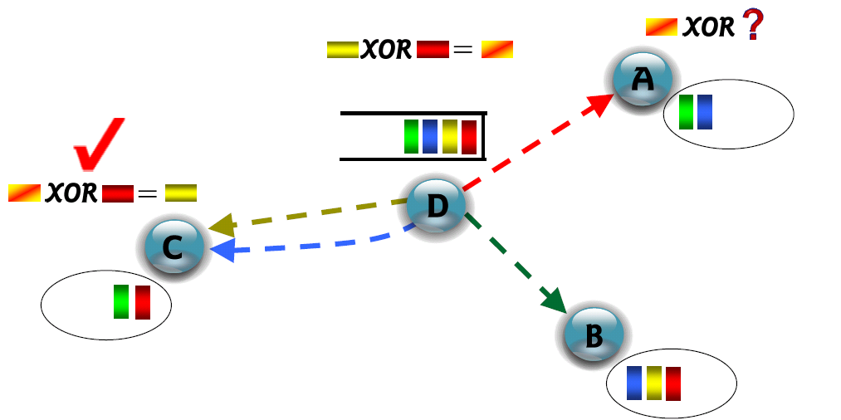
Opportunistic Coding
Bad Coding
Only one neighbor benefits
Illustration Credit: Author’s slide at SIGCOMM’06

Slide 15
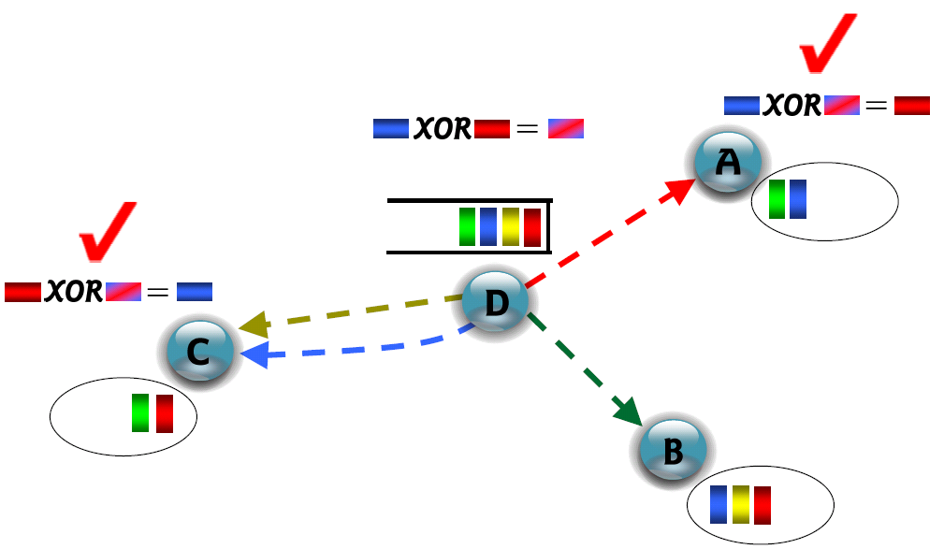
Opportunistic Coding
Good Coding
Two neighbor benefits
Illustration Credit: Author’s slide at SIGCOMM’06

Slide 16
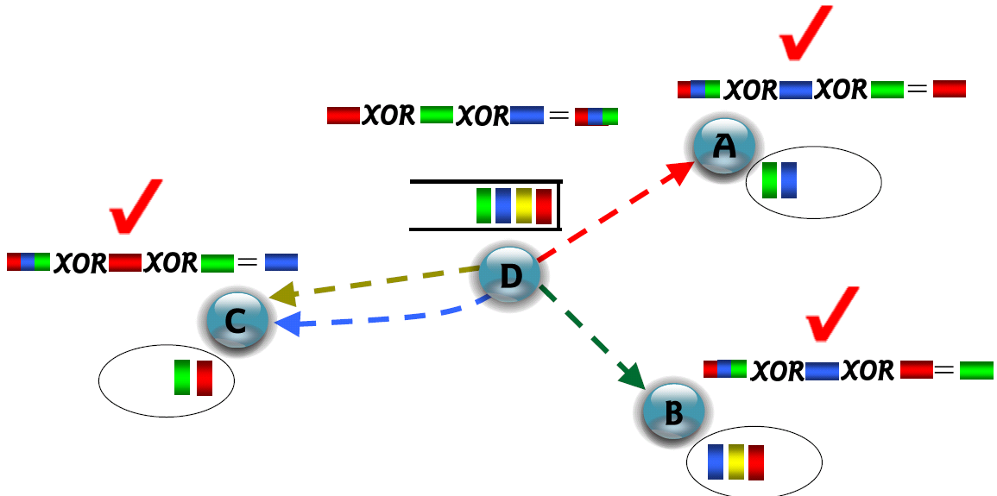
Opportunistic Coding
Better Coding
Three neighbor benefits
Illustration Credit: Author’s slide at SIGCOMM’06

Slide 17
Learning Neighbor State
Opportunistic Listening
Opportunistic Coding
Learning Neighbor State
Just reception reports may not be enough, guesswork is sometimes necessary.
ETX metric computes the delivery probability between nodes.
Pr { A particular neighbor has a packet }
= The delivery probability of the link between the packet’s previous hop and the neighbor.

Slide 18
Coding Gain
No. of transmissions required without COPE
No. of transmissions used by COPE
“In the absence of opportunistic listening, COPE’s maximum coding gain is 2, and it is achievable.”
Coding Gain achievable = 2N/(N+1)
This value tends to 2 as N grows.

Slide 19
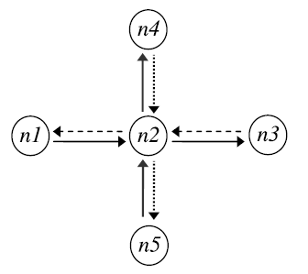
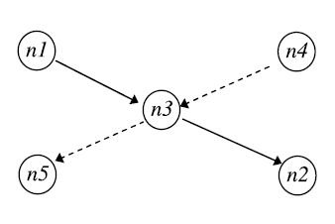
Coding Gain
Coding gain = 4/3 = 1.33
Coding gain = 8/5 = 1.6

Slide 20
But ….
Observation
Throughput improvement using COPE greatly exceeded the coding gain.
Guess Why ??

Slide 21
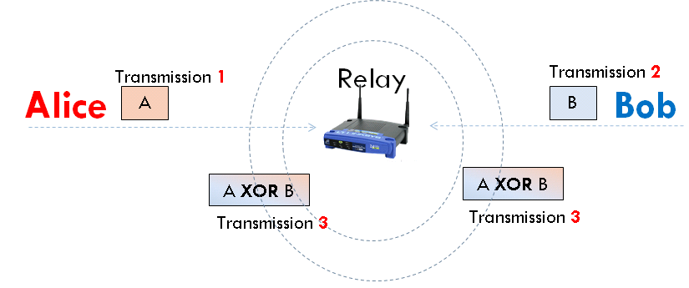
Contention !!
802.11 MAC PCF tries allocate medium equally between contending nodes.
When a bottleneck link uses cope, not only throughput is increased, but medium is also more contention free !!
Router drops packets twice as fast ..

Slide 22
Coding + MAC Gain
With single bottleneck
Draining rate with COPE
Coding + MAC Gain =
Draining rate without COPE
Coding + MAC gain = 2
Coding + MAC gain = 4

Slide 23
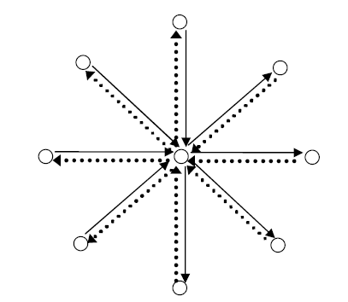
Coding + MAC Gain
With opportunistic listening, COPE’s maximum Coding + MAC gain is unbounded !!
N -> ∞

Slide 24
Design Issues
Never delay packets
Should not wait for additional codable packets to arrive.
Give preference to XORing packets of similar lengths and keep multiple virtual queues per neighbor based one for each packet size!
Never code together packets headed to the same next-hop.
Out of order can confuse the TCP and trigger congestion.
Consider packets according to their order in the queue
Ensure that each neighbor to whom packet is headed has a high probability of decoding it’s native packet.
Implements a pseudo-broadcast consisting of multiple unicasts to work-around default broadcast’s poor reliability and lack of backoff mechanism.

Slide 25
Experimental Results
Metrics Used
Network Throughput (Total end-to-end throughput)
Throughput Gain (with and without COPE)
Three Scenarios
COPE in toy topologies
COPE in an Ad Hoc Network
COPE in a Mesh Access Network

Slide 26
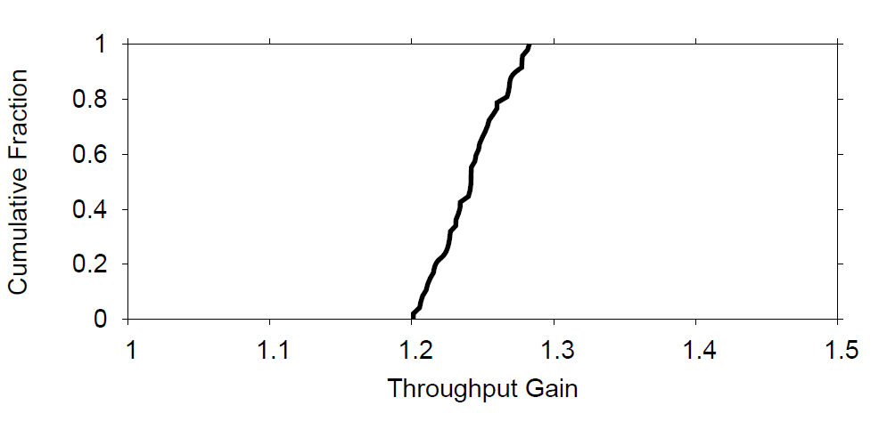
Long lived TCP, Alice-Bob Topology
Throughput gain corresponds to only Coding Gain.
Congestion control in TCP balances the draining rate at the bottleneck.

Slide 27
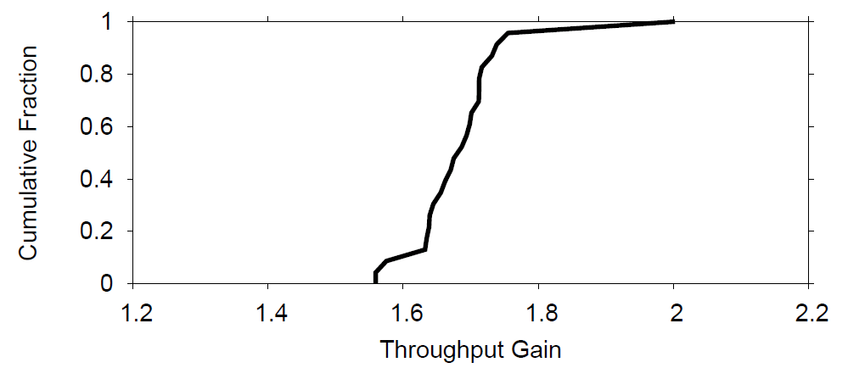
UDP, Alice-Bob Topology
Here, the throughput gain also corresponds to MAC + Coding Gain.
Reduction in throughput is due to XOR header overhead, imperfect overhearing and flow asymmetry.

Slide 28
COPE in an Ad Hoc Network
TCP flows arrive according to a Poisson process, pick sender and receiver randomly, and the traffic models the Internet.
TCP does not show significant improvement (2-3%): Collision related losses due to hidden terminals!
Authors repeat experiment, with varying no. of MAC retries, and with RTS/CTS enabled. COPE is not applied.
Even after 15 MAC retries, there is 14% loss, and the bottleneck nodes never see enough traffic. Few coding opportunities arise!

Slide 29
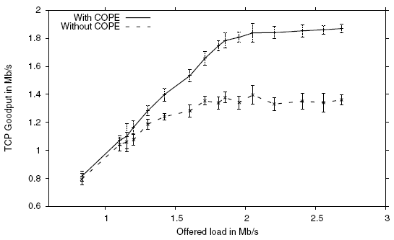
TCP, Ad Hoc Network
COPE performs well without hidden terminals

Slide 30
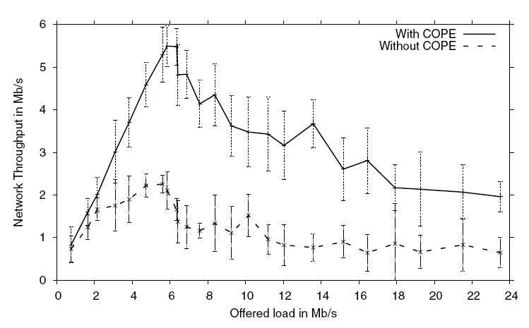
UDP, Ad Hoc Network

Slide 31
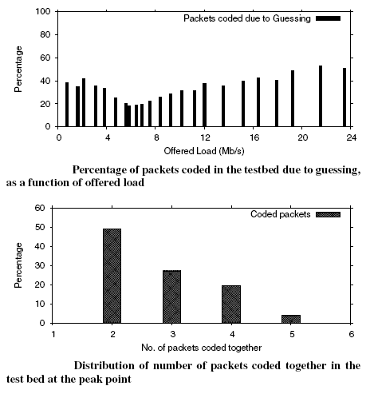
Guessworks …

Slide 32
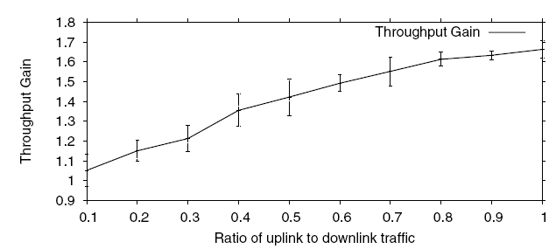
COPE in a Mesh Access Network
UDP Flows are used, and uplink/downlink traffic is adjusted.

Slide 33
Summary
For toy topologies, TCP flows get lower (no MAC gain) boost than UDP flows.
When the wireless medium is congested and the traffic consists of many random UDP flows, COPE increases the throughput 3-4x.
In the absence of congestion controlled traffic (UDP), COPE’s throughput improvement may substantially exceed the expected theoretical coding gain. (Coding + MAC gain)
For a mesh network connected to the Internet via an access point, the throughput improvement varies depending on the ratio between total download and upload traffic traversing the access point.
Ranges from 5% to 70%.
Hidden terminals create a high collision rate that cannot be masked even with the maximum number of 802.11 retransmissions.
In these environments, TCP does not send enough to utilize the medium, and thus does not create coding opportunities.
With no hidden terminals, TCP’s throughput increases by an average of 38% in the testbed.

Slide 34
Other types of Coding the wireless
MORE
Trading Coordination for Randomness
SIGCOMM 2007
MIXIT
Symbol level network coding
SIGCOMM 2008

Slide 35
Trading Structure for Randomness in Wireless
Opportunistic Routing
Szymon Chachulski Michael Jennings Sachin Katti Dina Katabi
SIGCOMM 2007

Slide 36
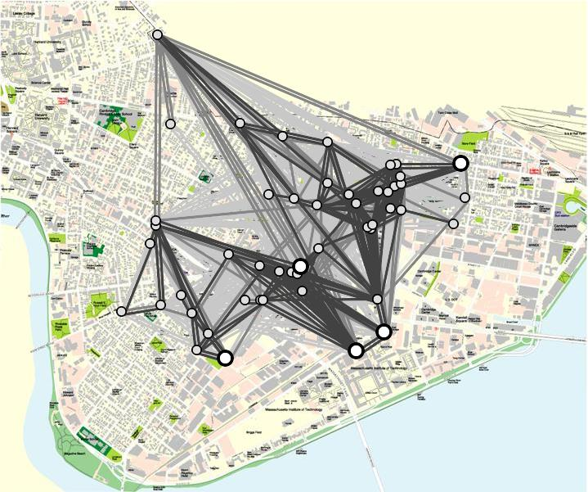
Roofnet
High loss rate wireless links
Avg. 30% loss
Author’s slide at SIGCOMM’07

Slide 37
Use Opportunistic Routing
R1
50%
0%
R2
0%
50%
src
dst
50%
0%
R3
50%
0%
R4
Best single path → loss prob. 50%
Author’s slide at SIGCOMM’07

Slide 38
Use Opportunistic Routing
R1
50%
0%
R2
0%
50%
src
dst
50%
0%
R3
50%
0%
R4
Best single path → loss prob. 50%
Any router that hears the packet can forward it → loss prob. 0.5⁴ = 6%

Slide 39
But
Overlap in received packets → Routers forward duplicates
P₁
R1
P₂
P₁
src
dst
P₂
P₁₀
R2
P₁
P₂

Slide 40
MORE’s Strategy
Each router forwards random combinations of packets
P₁
R1
α P₁+ ß P₂
P₂
src
dst
P₁
R2
γ P₁+ δ P₂
P₂
Randomness prevents duplicates
No scheduler; No coordination
Simple and exploits spatial reuse

Slide 41
MORE
Source sends packets in batches
Forwarders keep all heard packets in a buffer
Nodes transmit linear combinations of buffered packets
a
P1
+ b
P2
+ c
P3
=
a,b,c
src
A
B
dst
P1
4,1,3
4,1,3
8,4,7
P2
0,2,1
8,4,7
P3
2
4,1,3
+ 1
0,2,1
=
8,4,7
Author’s slide at SIGCOMM’07

Slide 42
MORE
Source sends packets in batches
Forwarders keep all heard packets in a buffer
Nodes transmit linear combinations of buffered packets
Destination decodes once it receives enough combinations
Say batch is 3 packets
1
P1
+ 3
P2
+ 2
P3
=
1,3,2
5
P1
+ 4
P2
+ 5
P3
=
5,4,5
4
P1
+ 5
P2
+ 5
P3
=
4,5,5
Destination acks batch, and source moves to next batch

Slide 43
Throughput of All Source-Destination Pairs
CDF of 180 source-destination pairs
1
0.8
0.6
0.4
0.2
0
Current
ExOR
MORE
Throughput [packets/s]

Slide 44
Comparison of COPE and MORE
 | COPE | MORE
Coding Method | XOR | Random Linear Combination
What Packets Coded | Packets of Different flows | Packets of same flows
Memory Requirement | End host needs to remember what it received in last T seconds | End host doesn’t need to remember anything.
Correctness | Needs k-1 native packets if an encoded packet was XOR-ed k times | Needs to receive k linearly independent packets

Slide 45
Symbol-level Network Coding for
Wireless Mesh Networks
Sachin Katti, Dina Katabi, Hari Balakrishnan, and Muriel Medard
SIGCOMM 2008

Slide 46
Wireless links are unreliable
R1
99% (10⁻³ BER)
0%
S
D
0%
99% (10⁻³ BER)
R2
Even 1 bit in 1000 incorrect → Packet loss of 99%
Author’s slide at SIGCOMM’08

Slide 47
Wireless links are unreliable
R1
99% (10⁻³ BER)
D
Loss
0%
S
Loss
0%
99% (10⁻³ BER)
R2
Remember spatial diversity !! Errors are not likely to overlap in different routers.

Slide 48
What Should Each Router Forward?
R1
S
D
P1
P1
P2
R2
P2
P1
P2

Slide 49
What Should Each Router Forward?
R1
S
D
P1
P1
P2
P1
P2
R2
P2
P1
P1
P2
P2
But overlap in correctly received symbols
Potential solutions
Forward everything → Inefficient
Coordinate → Unscalable

Slide 50
MIXIT Prevents Duplicates using Symbol Level Network Coding
R1
S
D
P1
P1
P2
R2
P2
P1
P2
Forward random combinations of correct symbols

Slide 51
MIXIT Prevents Duplicates using Symbol Level Network Coding
R1
…
D
…
…
R2
…
…
…
Routers create random combinations of correct symbols

Slide 52
MIXIT Prevents Duplicates using Symbol Level Network Coding
R1
…
D
R2
…
Solve 2
equations
Randomness prevents duplicates without co-ordination
Destination decodes by solving linear equations

Slide 53
MIXIT Prevents Duplicates using Symbol Level Network Coding
R1
…
D
…
…
R2
…
…
…
Routers create random combinations of correct symbols

Slide 54
Throughput Comparison
CDF
2.1x
MIXIT
3x
MORE
Shortest Path
Throughput (Kbps)

Slide 55
Take Home Points …
Coding in wireless networks have significant benefits compared to wired counterpart.
Probably some patches are necessary for TCP to cope up with the wireless gotchas.
Hints: Wireless is generally the first hop.
Don’t blame the broadcast nature of wireless. You can tame it for your benefit.
RTS-CTS is probably a toy solution to a much harder problem
We can algorithmically approach the combat hidden terminals to increase throughput mileage …
Decreasing medium contention is rewarding.

Slide 56
Discussion
What could be an optimal queue monitoring strategy, and what about the bounds on the queues?
COPE exploits inter-flow coding, MORE exploits intra-flow coding. Can we exploit both at the same time?
What type of networks/traffic will benefit from this architecture ? Can we place relay nodes strategically?
Traditional TCP with wireless access points ?
Telecom Networks ?
Content Delivery Networks ?
Sensor Networks ?
Wireless Ad Hoc Networks ?

Slide 57
Backup Slides

Slide 58
Data Structures
Output Queue
Two per-neighbor virtual queues
(For small and large packet sizes)
Hash table
(Keyed on packet-id)

Slide 59
Packet Decoding
Each node maintains a packet pool
When a node receives an XORed collection of packets, it searches for the corresponding native node from it’s pool
It ultimately XORs the n - 1 packets with the received encoded packet to retrieve it’s own native packet.

Slide 60
Pseudo Broadcast
In 802.11 CSMA/CA, there is RTS-CTS-ACK mechanism.
Exponential back-off if an ack is not received.
For 802.11 Broadcast, ack mechanism is unclear.
Who will ack ??
The solution is Pseudo-Broadcast.

Slide 61
Local Retransmissions
Probability of loss
Not receiving synchronous ACKs.
When next-hop actually does not have enough information to decode it’s native packet.
But since there is an overhead with extra headers, encoded packets are acked asynchronously.
Retransmission event is scheduled
Next-hop that received an encoded packet also schedules an ack event.

Slide 62
Preventing TCP Reordering
Asynchronous acks can cause reordering. As mentioned before, reordering can be confused by TCP as a sign of congestion.
COPE maintains an ordering agent
All non-TCP packets and packets whose final IP destinations are different from the current node are taken to the next level.
Others are ordered! (Using TCP seq numbers)

Slide 63
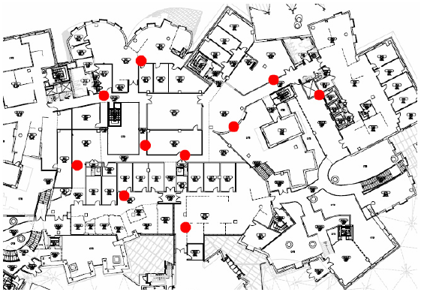
Backup: Experimental Setup
Testbed
20 Node testbed that spans two floors, with offices, passages, etc.,
Next-hops are between 1 and 6 hops in length, loss rates range between 0 – 30%,
Experiments are run on 802.11a (Bit-rate = 6Mbps)
COPE is implemented using the Click toolkit (?)
Routing Protocol – Srcr (Uses Dijikstra’s shortest path algorithm with link weights based on the ETT metric)
The hardware cards used operate in the 802.11 ad-hoc mode, with RTS/CTS “disabled”!
udpgen for UDP traffic; ttcp for TCP traffic.
The long-lived and short-lived flows have Poisson arrivals, with a pareto file size of shape parameter 1.17

Slide 64
Experimental Setup
Implemented MORE in Linux
20-node testbed
Compare MORE with:
Current Routing (Single Best Path)
ExOR (State-of-the-art Opportunitic Routing)
Experiment
Random source-destination pairs
Transmit 5 MB file

